Slide 1
Collections and generics
Ronnie Holm
Lecture 4

Slide 2
Agenda
Data structures and simple arrays
Collection classes in .NET
Problems with non-generic collection classes
Introducing generics
Examples of generic collection classes

Slide 3
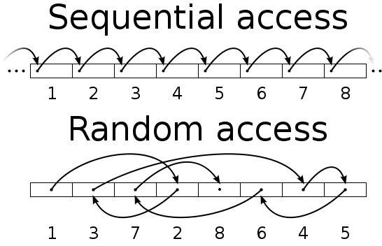
What’s a data structure?
Particular way of storing and organizing data in a computer so that it can be used efficiently
Different kinds of data structures are suited to different kinds of applications
Data structures and algorithms go together
Notes:
- When we think of a "structure" we often think of architecture, but data also has structure - There’re many different types of data structures: arrays, graphs, queues, stacks, and so on - Generally speaking, any class is an example of a data structure - We use these structures to be able to effectively store and access data - Data structures provide a means to manage large amounts of data efficiently - Efficient data structures are key to designing efficient algorithms - Implementing data structures usually require writing procedures that create and manipulate instances of structure - Generally speaking, any method on a class is an algorithm - http://invisiblecomputer.wonderhowto.com/inspiration/coding-fundamentals-introduction-data-structures-and-algorithms-0135613/ - http://www.devilsduke.com/running-time-complexity-functions-summarized/2556/

Slide 4
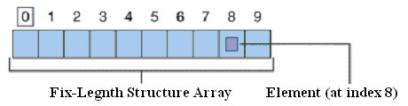
Array
class Program {
static void Main(string[] args) {
string[] a = {
"First", "Second", "Third"
};
Console.WriteLine(a.Length);
foreach (string s in a) {
Console.WriteLine(s);
}
Array.Reverse(a);
foreach (string s in a) {
Console.WriteLine(s);
}
}
}
Most simple container
Define a set of identically typed items of fixed upper limit
Arrays are really instances of System.Array class
3
First
Second
Third
Third
Second
First
Notes:
- Basic arrays are useful for managing small amounts of fixed-size data - An array is a series of values associated with a numerical index - Many times you want a more flexible data structure, such as a dynamically growing or shrinking container

Slide 5
Collection classes
Two broad categories
Non-generic collections
Operate on Object type and is loosely typed
No need to use these anymore except for backward-compatibility
Generic collections
Must specify ”type of type” they contain upon creation
Generics involve type parameters, such as List<T> instead of just ArrayList
Notes:
- Generics was added in .NET 2.0 - Before generics: use System.Collections namespace - After generics: use System.Collections.Generics namespace - Collection classes overcome the limitations of simple arrays - Collection classes typically resize themselves as you insert or remove items - Many classes offer increased type-safety - Optimized to process contained data in a memory-efficient manner

Slide 6
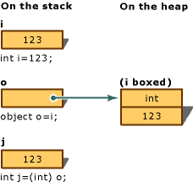
Problems of non-generic collections
Object
Performance
Boxing/unboxing is convenient for programmer
Stack/heap memory transfer is a performance issue
ValueType
String
Int32
int ArrayList.Add(object value)
object ArrayList[int index]
class Program {
static void Main(string[] args) {
// make a value type variable
int i = 123;
// box into object reference
object o = i;
// unbox reference back into
// corresponding value type
int j = (int)o;
}
}
Notes:
- Performance - Performance optimization with regular variables now comes back and bites us - ValueType descendent are stack allocated - All other types are heap allocated - With non-generic collections you need to store stack variable as heap variable - ArrayList has been build to operate on objects, which represent data allocated on the heap - When you pass in numerical data, the runtime automatically boxes the stack-based data on your behalf - You explicitly have to unbox using casting syntax - Boxing - .NET mechanism to store data in a value type within a reference variable - Assigning a value type to an Object variable - When boxing a value, CLR allocates a new object on heap and copies the value type’s value into instance - Garbage collector now has to dispose of object rather than exiting a scope - Unboxing - Converts a value held in a object reference back into a value type on the stack - Unboxing syntactically looks like a normal casting operation, but semantics is quite different - CLR verifies that receiving data type is equivalent to boxed type - Copies value back into a local stack-based variable - Example - Boxing/unboxing allows you to assume everything can be threated as Object - CLR takes care of memory-related details on your behalf - Boxing is implicit; unboxing is explicit - http://msdn.microsoft.com/en-us/library/yz2be5wk.aspx

Slide 7
Problems of non-generic collections (2)
Type safety is lacking because collection can store all object descendants
Typically the container should hold one and only one type
class Program {
static void Main(string[] args) {
ArrayList a = new ArrayList();
// value types are automatically boxed when
// passed to member requirering object
a.Add(10); // will not generate a compiler-error, // but only a runtime-error if and when // you access the element a.Add("x");
// unboxing occurs when an object is
// converted back to stack-based data
int i = (int) a[0];
// now data is reboxed as WriteLine
// requires object types for args
Console.WriteLine("{0}", i);
}
}
Notes:
- Before .NET 2.0, for type safety you’d have to copy/paste a collection class, only changing its type - Creating an almost identical custom collection for each unique data type is a bad solution - Custom collection classes does nothing to solve the boxing/unboxing penalties

Slide 8
Generic collection classes
Generic classes rectify boxing/unboxing penalties and lacking type safety
Specify type using a type parameter
Runtime generates classes on demand
class Program {
static void Main(string[] args) {
List<int> i = new List<int>();
// void List<int>.Add(int item)
i.Add(1);
// generates a compile time error
//i.Add("2"); // no casts required int a = i[0];
List<string> s = new List<string>();
// void List<string>.Add(string item)
s.Add("1");
}
}
Notes:
- Example using List<int> - No boxing/unboxing required - Benefits of generic containers over non-generic containers - Better performance because boxing/unboxing isn’t required - Type safety because they can contain only the type you specify (compile time safety) - Reduces need to build custom collection types because of the type parameter

Slide 9
Revisiting routines and type parameters
What is a routine really?
Code parameterized by routine arguments
What is generics really?
Code parameterized by type arguments
Only classes, structures, interfaces, and delegates can be written generically
void Swap(ref int a, ref int b) {
int temp = a;
a = b;
b = temp;
}
void Swap<T>(ref T a, ref T b) {
T temp = a;
a = b;
b = temp;
}
Notes:
- With routines, the things that vary become arguments/local variables - With generics, the things that vary get replaces before instance is created - Think of a type parameter as a placeholder - At runtime, think of type creation as CLR doing a search and replace on type parameters - When you create a generic type or invoke a generic member, it’s up to you to supply a value for the type parameter - Compare with overloading - Overloading is the act of defining multiple versions of a single method which differ by number or type of arguments - Leads to many methods essentially doing the same thing - Whenever a group of overloaded methods differ only by types of arguments, generics should be used
- Parametric polymorphism - Function or data type can be written generically so it can handle values without depending on their type

Slide 10
Collection initialization syntax
To collections what object initialization syntax is to objects
Works with classes supporting Add method
class Program {
static void Main(string[] args) {
// initializing standard array
int[] a = { 1, 2, 3 };
// initializes List<int> implementing ICollection<int>
List<int> b = new List<int> { 1, 2, 3 };
// intializes ArrayList implementing ICollection
ArrayList c = new ArrayList { 1, 2, 3 };
}
}
Notes:
- Compare to object initialization syntax used to set properties on a new variable at construction time - For poplating collections using the same syntax used when populating basic arrays - Works with classes that support the Add methods from ICollection<T>/ICollection interfaces - Combine with object initialization syntax to create individual member before adding to array - Compiler rewrites code to call Add method on collection class

Slide 11
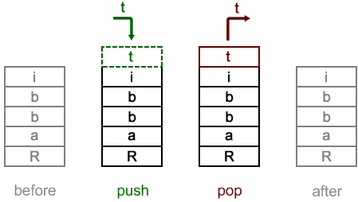
Working with Stack<T>
Last in-first out data structure
class Program {
static void Main(string[] args) {
Stack<int> i = new Stack<int>();
i.Push(1);
i.Push(2);
Console.WriteLine(i.Peek());
Console.WriteLine(i.Pop());
Console.WriteLine(i.Pop());
}
2
2
1

Slide 12
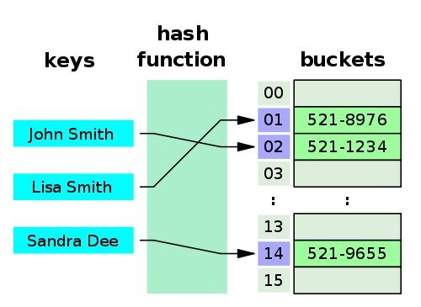
Working with Dictionary<TKey, TValue>
Maps keys to values
Uses hash function to compute an index into an array of slots
class Program {
static void Main(string[] args) {
Dictionary<string, int> d = new Dictionary<string, int>();
d.Add("John Smith", 5218976);
d.Add("Lisa Smith", 5211234);
d.Add("Sandra Dee", 5219655);
Console.WriteLine(d["Lisa Smith"]);
}
}
5211234
Notes:
- Common data types have GetHashCode() defined - Default implementation does not guarantee unique return values for different objects - Objects used as key must override the GetHashCode() - Ideally, the hash function should assign each possible key to a unique bucket - Most hash table designs assume hash collisions occur and accommodate them in some way - http://en.wikipedia.org/wiki/Hash_table - http://msdn.microsoft.com/en-us/library/system.object.gethashcode.aspx

Slide 13
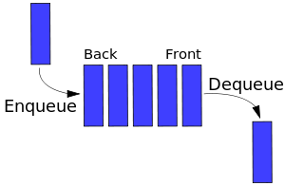
Working with Queue<T>
First in-first out data structure
class Program {
static void Main(string[] args) {
Queue<string> q = new Queue<string>();
q.Enqueue("a");
q.Enqueue("b");
q.Enqueue("c");
Console.WriteLine(q.Peek());
Console.WriteLine(q.Dequeue());
Console.WriteLine(q.Dequeue());
Console.WriteLine(q.Dequeue());
}
}
a
a
b
c
Notes:
- Named Enqueue and Dequeue instead of Add and Remove for historical reasons - First element added to queue will be first to be removed - Useful in software architecture - Used to create highly scalable systems - Enables a system to keep functioning under different kinds of loads - Enables restarting program dequeuing without affecting enqueuing - Response time for individual request is higher than direct calls, but more overall scalable approach - Skat tastselv system (QueueIT)

Slide 14
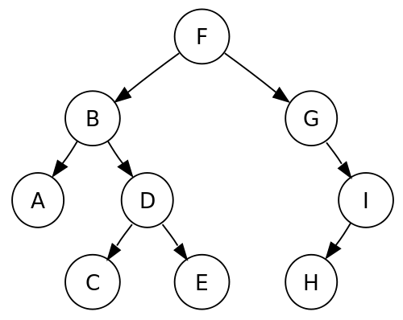
Working with custom Tree<T>
For representing hierarchical data
Defined recursively (locally) as a collection of nodes (starting at a root node)
Each node is a data structure consisting of a value, together with a list of nodes
No node must be duplicated
Traversing the tree
Pre-order
Post-order
In-order
F, B, A, D, C, E, G, I, H (root, left, right)
A, C, E, D, B, H, I, G, F (left, right, root)
A, B, C, D, E, F, G, H, I (left, root, right)
Notes:
- Hierachical data includes file system and XML - Compare with canonical traversal of list which is linear - Stepping through items of tree exactly once in a systematic way is called walking or traversing tree - Such traversals are classified by the order in which nodes are visited - From a given node there’s more than one possible next node - Starting at root of (binary) tree, three main steps can be performed and their order defines the traversal type - Steps include - Performing action on current node - Traversing to the left child node - Traversing to the right child node - Name given to particular style of traversal comes from order in which nodes are visited - Depth-first traversal is further classified by position of the root element with regard to the left and right nodes - Pre-order: visit root, traverse left subtree, traverse right subtree - Post-order: traverse left subtree, traverse right subtree, visit root - In-order: traverse left subtree, visit root, traverse right subtree - http://en.wikipedia.org/wiki/Tree_traversal

Slide 15
Working with custom Tree<T> (2)
public class Tree<T> {
public T Value;
public IList<Tree<T>> Children;
public Tree(T value) {
Value = value;
Children = new List<Tree<T>>();
}
public override string ToString() {
return ToStringRecursive(this, 0);
}
private string ToStringRecursive(
Tree<T> tree, int indentation) {
var seed = (new String(' ', indentation))
+ tree.Value + Environment.NewLine;
return tree
.Children
.Aggregate(seed, (current, next) => current +
ToStringRecursive(next, indentation + 2));
}
}
var root = new Tree<string>("root") {
Children = new List<Tree<string>> {
new Tree<string>("node-1") {
Children = new List<Tree<string>> {
new Tree<string>("node-1.1") {
Children = new List<Tree<string>> {
new Tree<string>("node-1.1.1")
}
},
new Tree<string>("node-1.2")
}
},
new Tree<string>("node-2")
}
};
var node = root.Find(n => n == "node-1");
Console.WriteLine(node);
/*
node-1
node-1.1
node-1.1.1
node-1.2
*/

